Slide 1

Bangladesh University of Business and Technology
Dept. name : Computer Science and Engineering
Course name : Software Development Project
Course code : CSE - 100
Project title : Hangman Guessing Game With C++
Intake : 51
Section : 06
Group no : 03
Submitted To : Khan Md. Hasib
Assistant Professor,
Department of,
CSE,BUBT
Submitted By :
Shariar Soton | 22235103105
Minhajur Rahman | 22235103129
Omar Faruk Fahim | 22235103132
Torikul Islam Lipon | 22235103255
Utsob | 22235103256

Slide 2





The Hangman’s
Shariar Soton
Minhazur Rahman Maruf
Omar Faruq Fahim
Md. Torikul Islam Lipon
Utsob

Slide 3

Welcome
To
Game

Slide 4
UNLOCK THE FUN: DIVE INTO OUR HANGMAN GAME ADVENTURE!

Slide 5
HANGMAN ADVENTURE!
Get ready to dive into the world of word puzzles and fun challenges. Join us on an exciting journey to uncover hidden words and unlock the thrill of Hangman!

Slide 6




What is hangman game?

Slide 7


The Hangman Game project is a digital adaptation of the classic word-guessing game. It involves guessing letters to uncover a hidden word within a chosen category. The code structure includes features like strategic hints, scoring, and high-score tracking. The game aims to provide entertainment, enhance vocabulary, and offer an interactive learning experience.

Slide 8

1.Choose a Category: Select a word category to narrow down the options.
2. *Guess Letters:* Attempt to guess the letters in the hidden word.
3. *Limited Attempts:* You have 6 number of attempts to guess the word.
4. *Request a Hint:* Players can use one hint per game to reveal a letter in the word.
5. *Avoid Repeated Guesses:* Don't guess the same letter again if it has already been tried.
6. *Solve the Word:* Try to solve the entire word within the given attempts.
7. *Winning:* Successfully guessing the word leads to victory, while running out of attempts results in a loss.
8. *Score Calculation:* The game calculates scores based on the remaining attempts, encouraging efficient gameplay.

Slide 9

Educational Benefit of Hangman Game
The Hangman Game is an engaging and educational tool that enhances cognitive skills and vocabulary. Players develop critical thinking and memory while exploring diverse word categories. Its multiplayer feature fosters social interaction, and educators can seamlessly integrate it into lessons for an enjoyable language-learning experience.

Slide 10
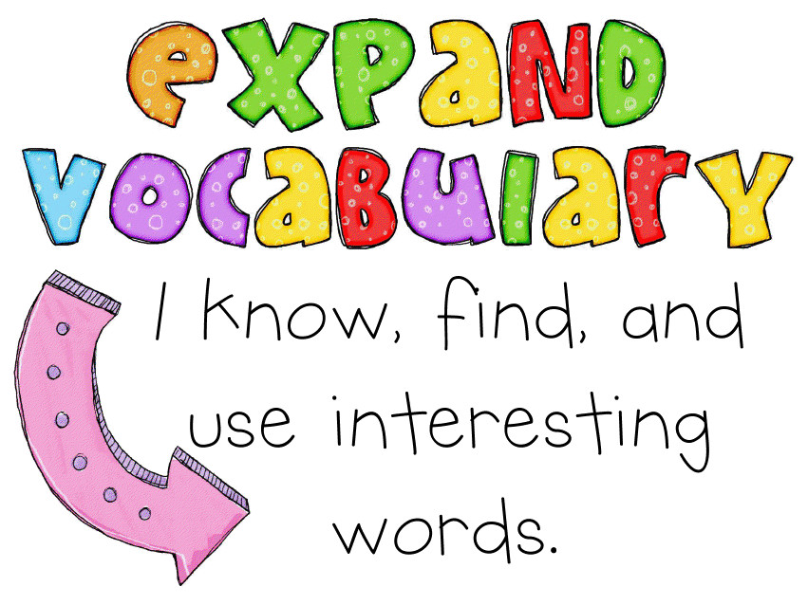
Vocabulary Expansion:
Hangman encourages players to think about and guess words, helping to expand their vocabulary. Players are exposed to new words, and the game can be especially useful for learners of a new language or for reinforcing vocabulary in a fun way.

Slide 11
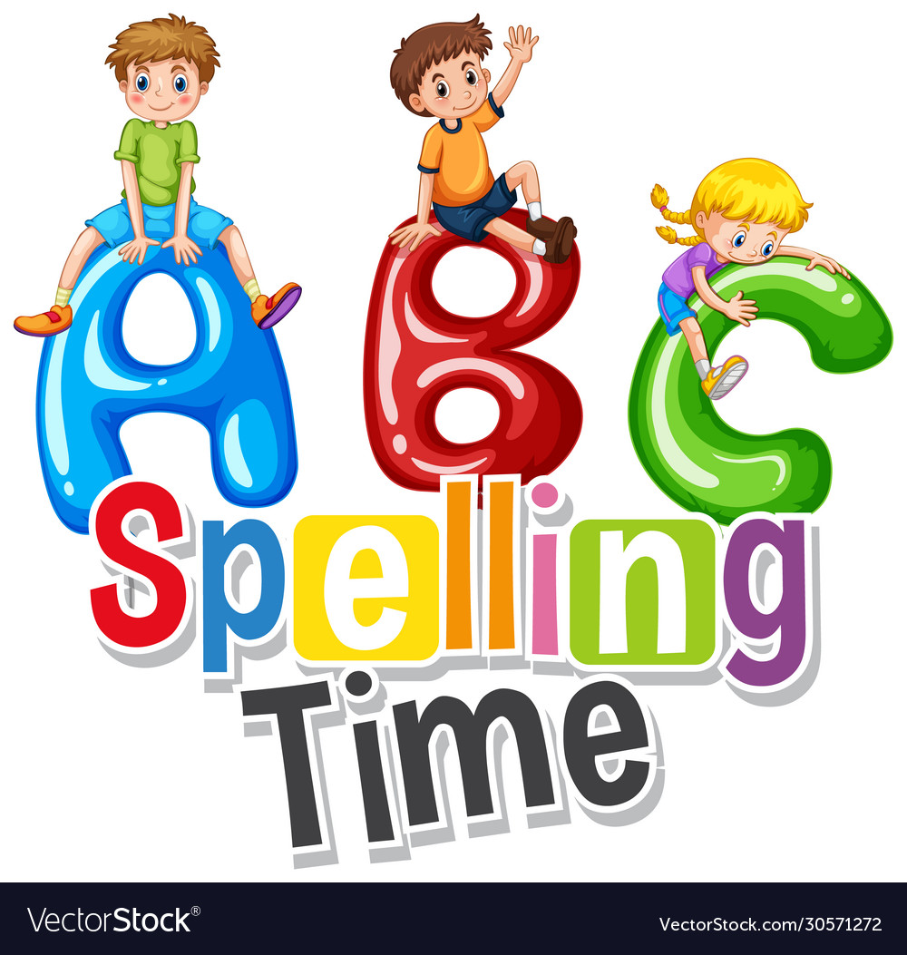
Spelling Practice
The game requires players to spell out words correctly. This can be particularly beneficial for younger players or those looking to improve their spelling skills. The visual representation of correct and incorrect letters reinforces spelling patterns.

Slide 12
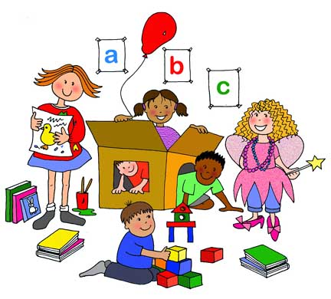
Word Recognition
As players encounter and guess different words, they improve their ability to recognize and recall those words in the future. This can contribute to faster and more efficient word recognition, which is beneficial for reading and comprehension.

Slide 13
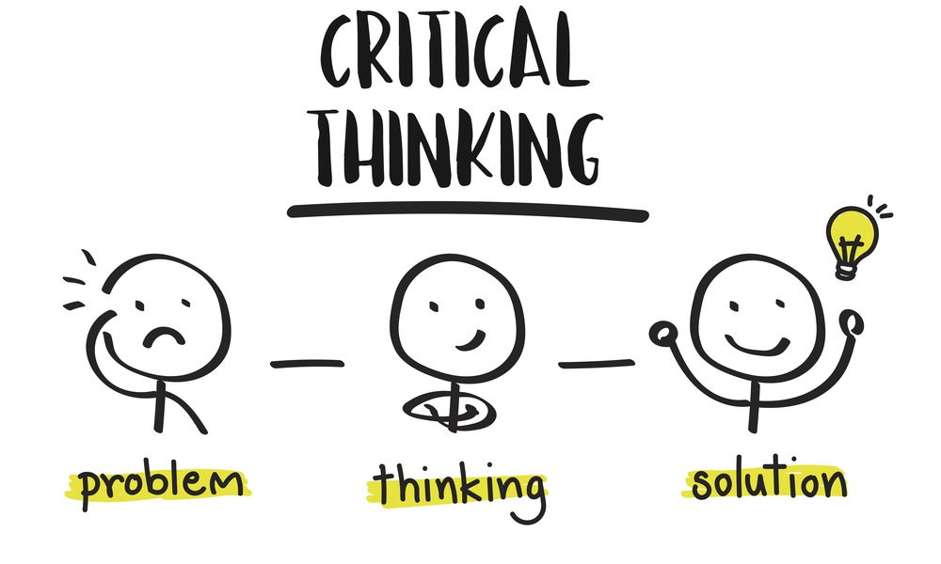
Critical Thinking
In the Hangman Game, players engage in critical thinking by strategically guessing letters to unveil a hidden word. Each guess requires careful consideration of potential options, encouraging problem-solving skills. The limited number of attempts adds a challenge, prompting players to analyze and choose letters thoughtfully, fostering cognitive development and enhancing their ability to think strategically.

Slide 14

Entertainment
Beyond its educational benefits, Hangman is simply a fun and entertaining game. It can be a enjoyable pastime for individuals or groups, providing a break from routine activities.

Slide 15

The key features of the Hangman Game include:
1. Classic Gameplay:
Users engage in the traditional letter-by-letter word guessing gameplay, suitable for players of all ages.
2. Strategic Hints:
Limited hints challenge players to think strategically, adding an element of decision-making to the game.
3. Scoring System:
The game incorporates a dynamic scoring system, encouraging players to optimize their gameplay by deducting points for hints.
4. High-Score Competition:
Players can compete for the top spot on the high-score leaderboard, fostering a sense of competition and achievement.
These features collectively contribute to an engaging and challenging word-guessing experience.

Slide 16

Interactive Gameplay
This project offers engaging gameplay with strategic elements. Users can input letter guesses, request hints, and enjoy visual feedback through Hangman ASCII art. The incorporation of sound effects enhances the dynamic experience. Winning scenarios are celebrated with visual displays, creating an interactive and enjoyable gaming environment.

Slide 17

The Code structure of the Hangman Game project
1. Class Definition:
The code defines a class named `HangmanGame` encapsulating the entire game logic.
2. Private Data Members:
The class includes private data members to store game-related information, such as the secret word, guessed word, maximum attempts, current category, hints left, score, and high scores.
3. Constructor:
The class has a constructor that initializes key parameters, including loading words from a file, selecting a category, and initializing the guessed word.
4. File Handling Functions:
Functions like `loadWordsFromFile` are responsible for reading words from an external file, categorizing them, and populating the game.
5. Game Initialization:
Methods like `selectCategory` and `selectWord` handle the initial setup, allowing users to choose a category and randomly selecting a word within that category.

Slide 18
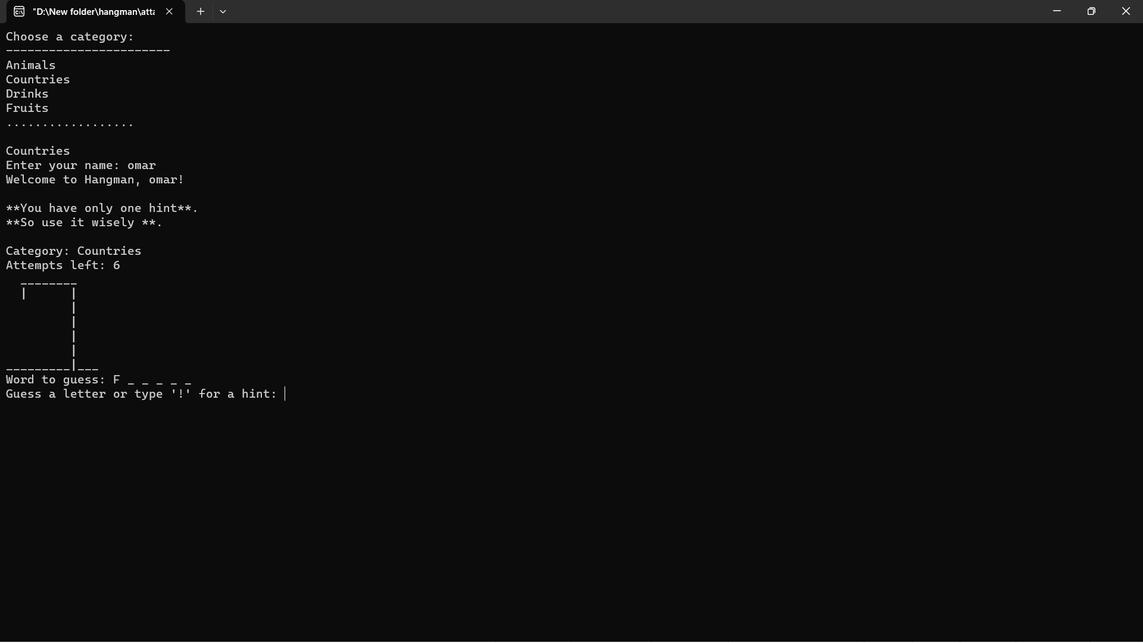
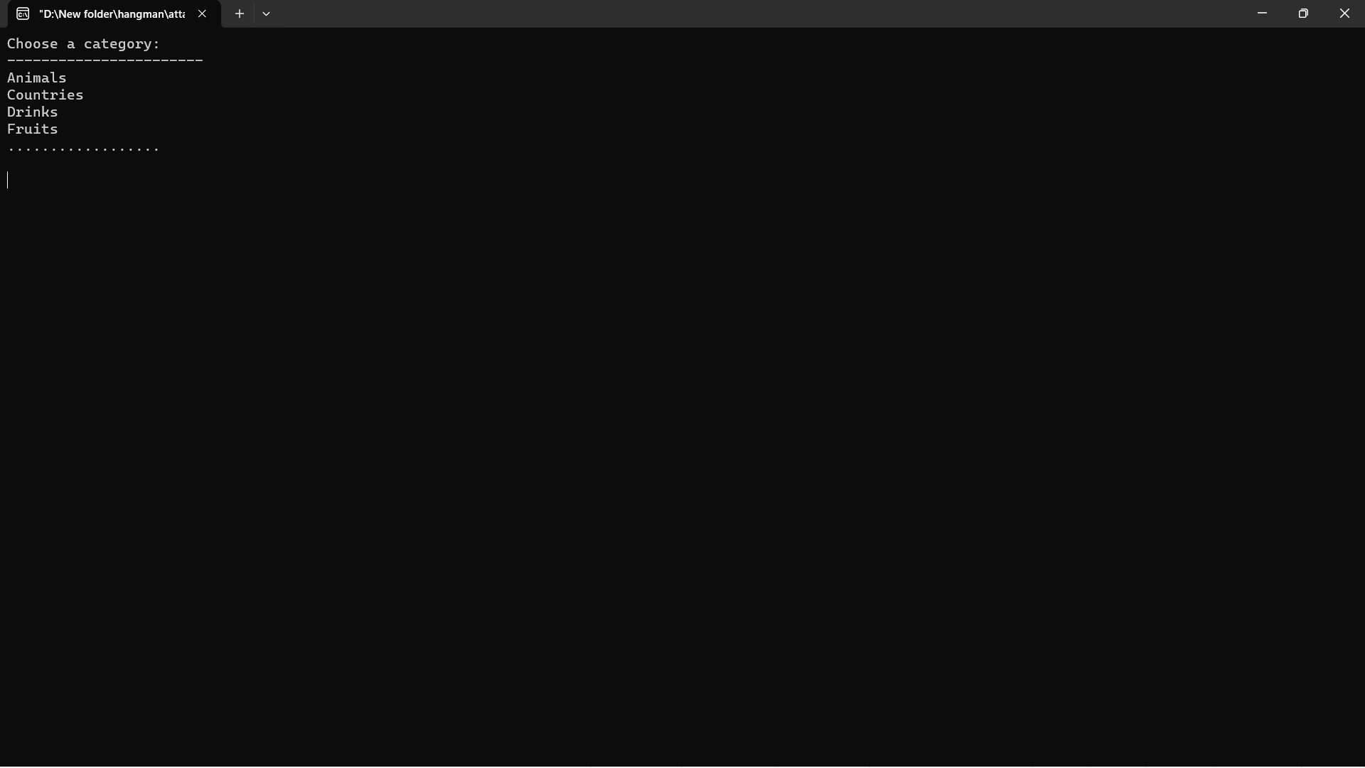
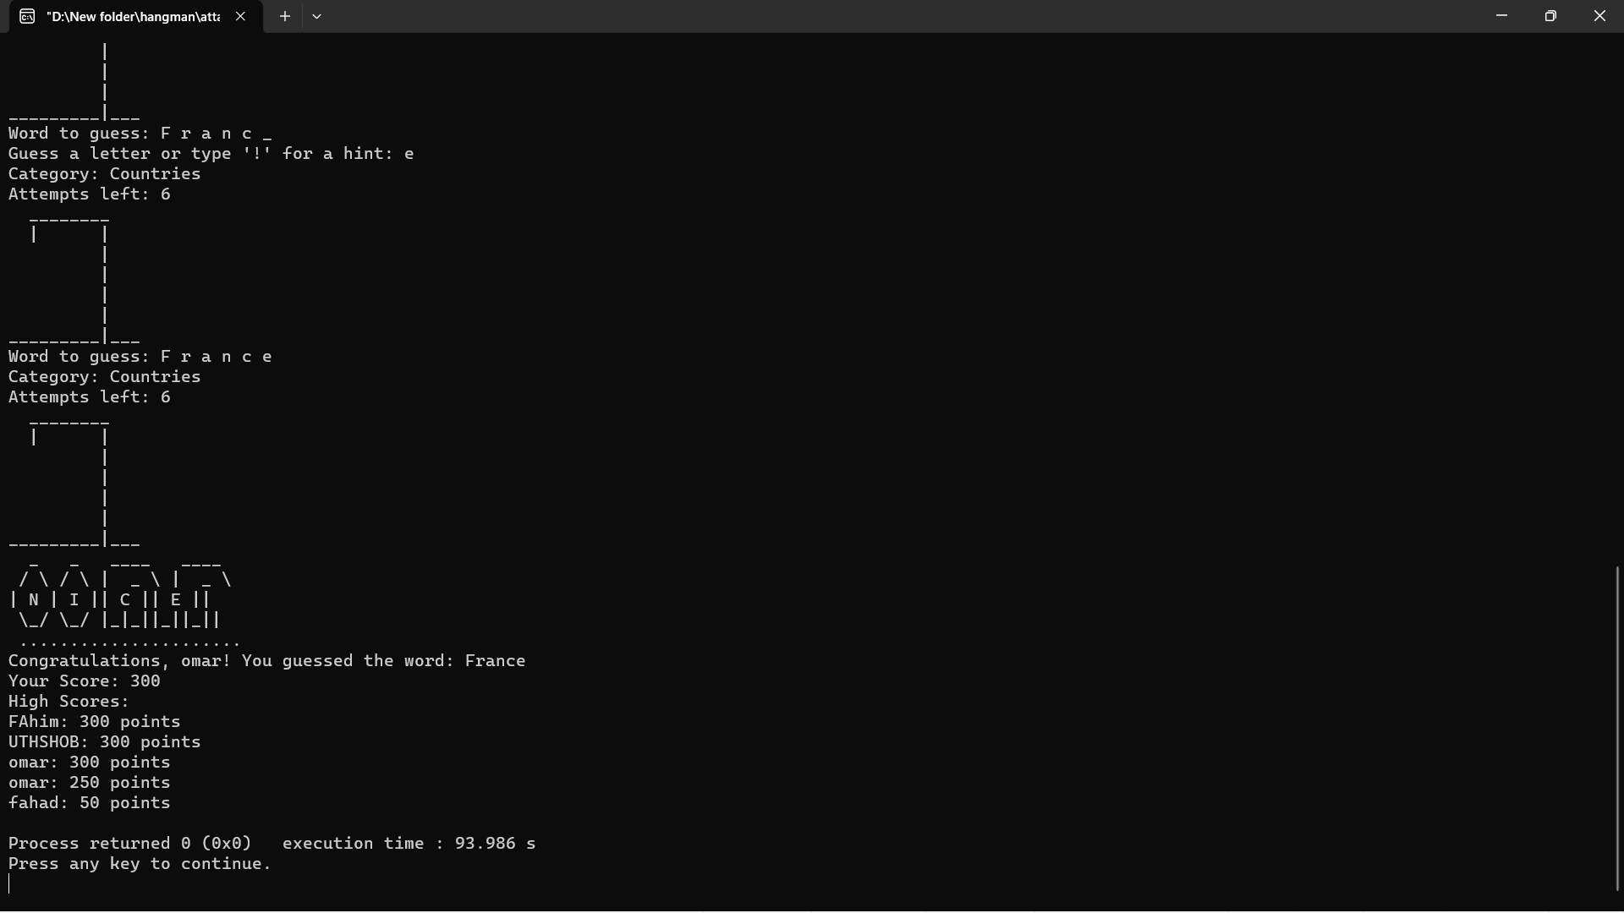
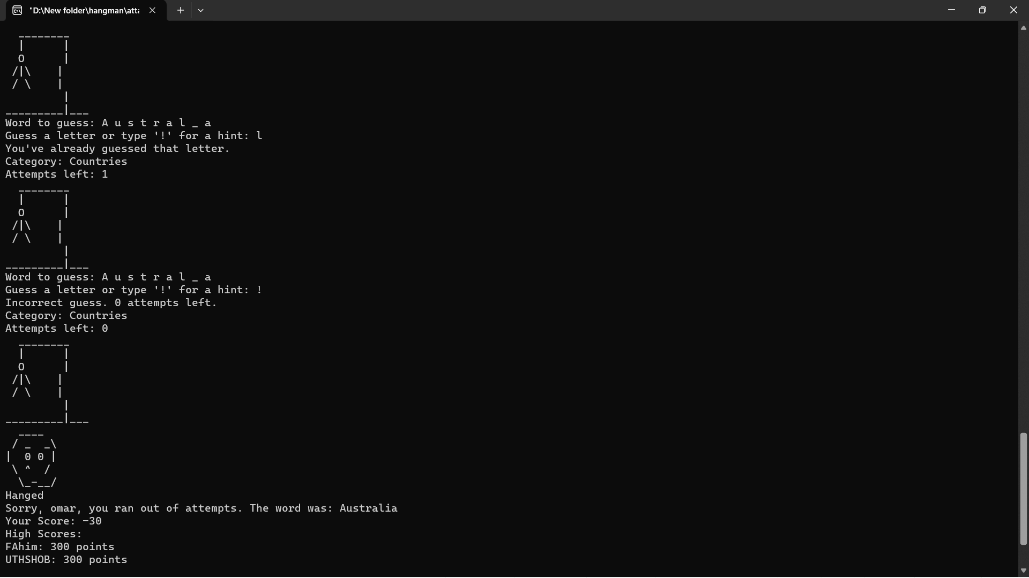
Output

Slide 19

6. Gameplay Loop:
The `play` function encapsulates the core gameplay loop, where users guess letters, receive hints, and progress through the game until either winning or running out of attempts.
7. Visual Feedback:
Functions like `displayHangman` and `displayGuessedWord` provide visual feedback to the user, showing the current state of the hangman and the guessed letters.
8. User Interaction:
User input is managed through functions like `provident` and `getPlayerName`, allowing players to interact with the game.
9. Score Management:
Functions like `calculateScore`, `checkHighScore`, and `saveHighScores` handle scoring and maintain a record of high scores.
10. Main Function:
The `main` function initializes an instance of the `HangmanGame` class, specifying the word file and maximum attempts, and then starts the game.

Slide 20

Future Enhancements
Platform Expansion:
Consideration for web or mobile platforms.
Enhanced Graphics:
Improved visuals for a more engaging experience.
Multiplayer Mode:
Potential addition for real-time competition.

Slide 21

Future enhancements for the Hangman Game project include potential expansion to web or mobile platforms, enriching the gaming experience with improved graphics for enhanced engagement, and the consideration of a multiplayer mode for real-time competition and social interaction. These developments aim to elevate the game's accessibility, visual appeal, and interactive features.

Slide 22

What we learn ?
Through this project, we'll learn to implement object-oriented programming concepts, handle file operations in C++, and manage data structures like vectors and maps. Additionally, we'll gain experience in creating a user-friendly interface, incorporating sound effects, and developing a scoring system. This project enhances your coding skills while providing insights into game design and educational software development.

Slide 23


Conclusion
In conclusion, our Hangman Game project seamlessly blends entertainment with cognitive stimulation. By offering a classic game with strategic hints, scoring, and personalized touches, we've created an engaging experience. The project not only entertains but also challenges users, promoting critical thinking and vocabulary expansion. It's a smart and fun journey that balances enjoyment with mental exercise.

